Slide 1






STOCK
MARKET
ANALYSIS
POWER BI
PRESENTATION
This Photo by Unknown Author is licensed under CC BY-SA

Slide 2
DASHBOARD
This dashboard presents a comparative view of the Top 5 market cap stocks — Reliance Industries, TCS, HDFC Bank, Infosys, and ICICI Bank.
It highlights their Valuation, Revenue Growth, Analyst Sentiment, and Institutional Investment Patterns, offering a 360° perspective for informed decision-making.

Slide 3
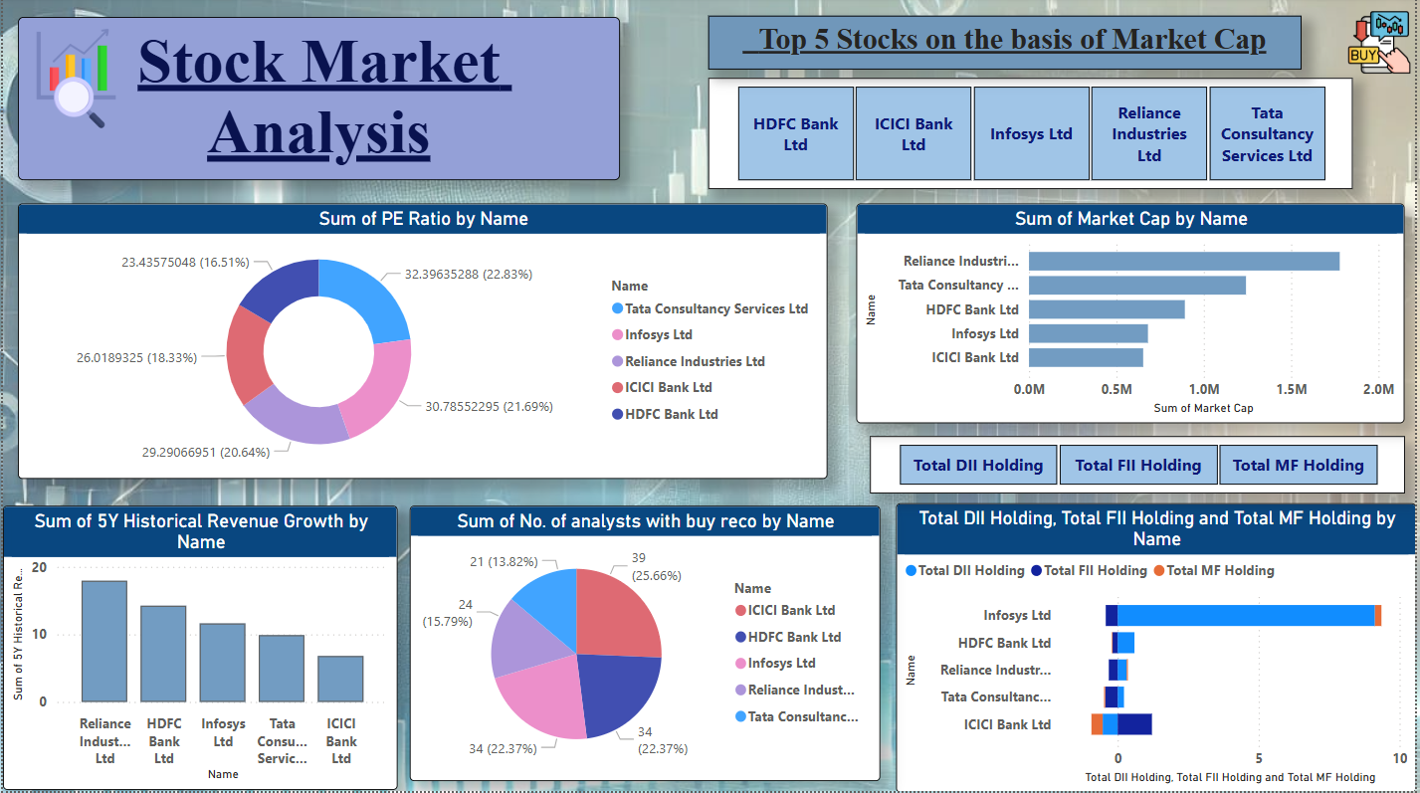
DASHBOARD
Reliance Industries leads in market cap and revenue growth, showcasing strong business performance.
TCS has the highest PE ratio, reflecting high investor expectations in the IT sector.
ICICI Bank received the most buy recommendations, indicating strong analyst confidence.
Infosys shows the highest Domestic Institutional Investor (DII) holding, signaling strong domestic trust.
All five stocks show balanced growth across valuation, analyst sentiment, and institutional interest—making them key players in the market.
Reliance Industries consistently performs well across all key metrics, making it the best-rounded stock among the five.

Slide 4
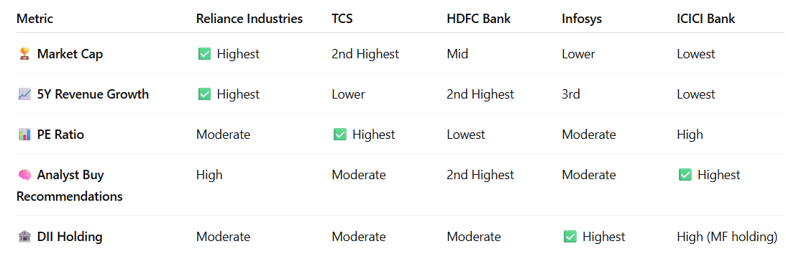
METRICS WISE PERFORMANCE

Slide 5
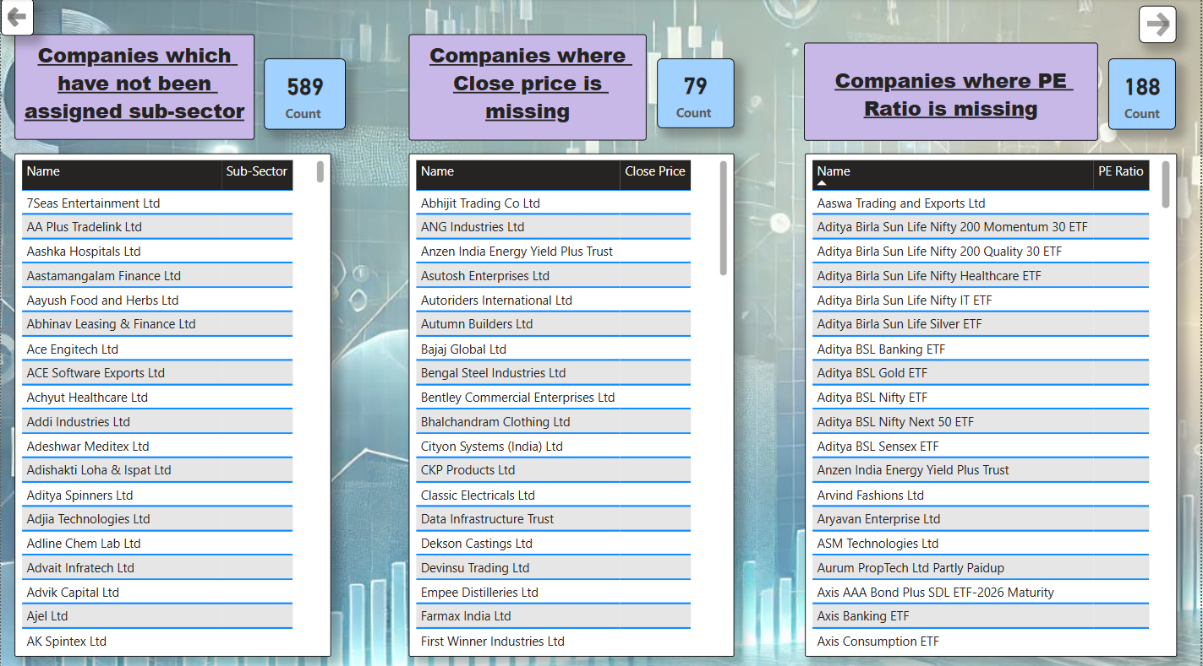
MISSING INFORMATION OVERVIEW
1. 589 companies are missing sub-sector classification, affecting industry-level segmentation and analysis.
2. 79 companies lack closing price data, which limits accurate valuation and performance tracking.
3. 188 companies are missing PE Ratio values, restricting fundamental analysis for investors.
4. Most missing PE data belongs to ETFs and trusts, which may not have conventional earnings ratios.
5. Cleaning and enriching this missing data is crucial for reliable stock analysis and decision-making.

Slide 6
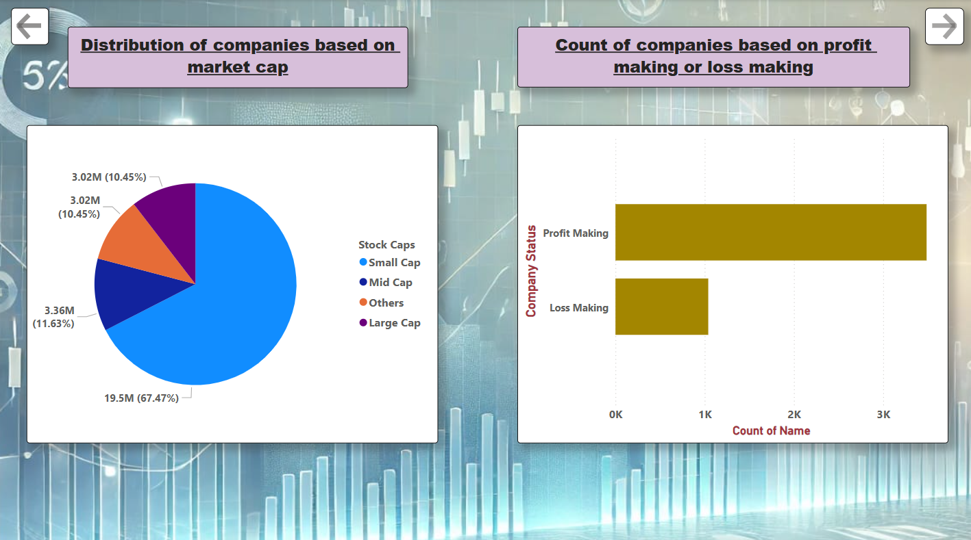
MARKET CAP AND PROFIT & LOSS MAKING
Small-cap companies dominate, making up 67.5% of the total market cap distribution
Mid-cap, large-cap, and other companies each account for around 10–11%, showing a relatively balanced but smaller presence
The market is heavily tilted toward smaller companies, which may indicate higher volatility and risk
A majority of companies are profit-making, suggesting positive overall market health
Loss-making companies still form a significant segment, signaling room for caution in stock selection

Slide 7
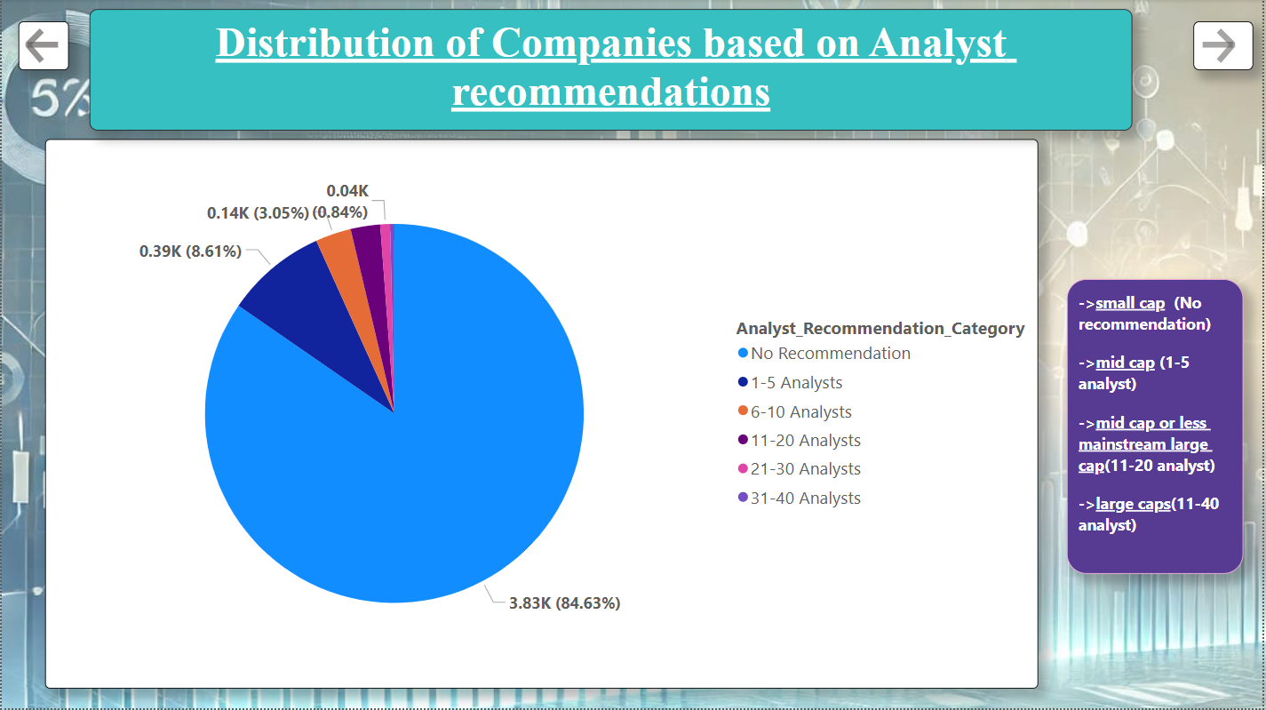
ANALYST RECOMMENDATION
Analyst coverage reflects market position and investor demand
85% companies receive no recommendations → Mostly small-cap firms with low visibility
Analyst attention increases with firm size → Mid-cap firms: 1–5 analysts on average
Only a few have 10+ analyst reviews → Indicates market relevance and trust
Companies with 11–20 analysts are typically mainstream large or strong mid-caps
Large-cap companies attract the most coverage → Covered by 11–40 analysts, showing high investor interest

Slide 8
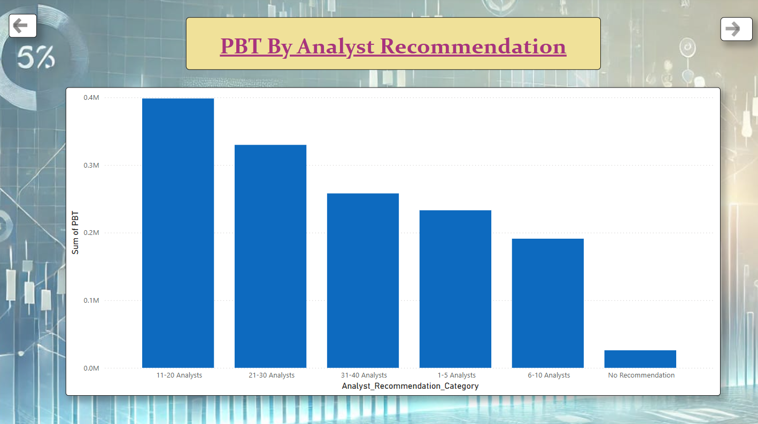
PBT BY ANALYST RECOMMENDATION
- Companies covered by 11–20 analysts have the highest total PBT
- 21–30 analysts and 31–40 analysts categories also show strong PBT values but slightly lower than the first group.
- Companies with 1–5 analysts and 6–10 analysts have lower total PBT compared to highly covered companies.
- The No Recommendation category has the lowest total PBT, almost negligible.

Slide 9
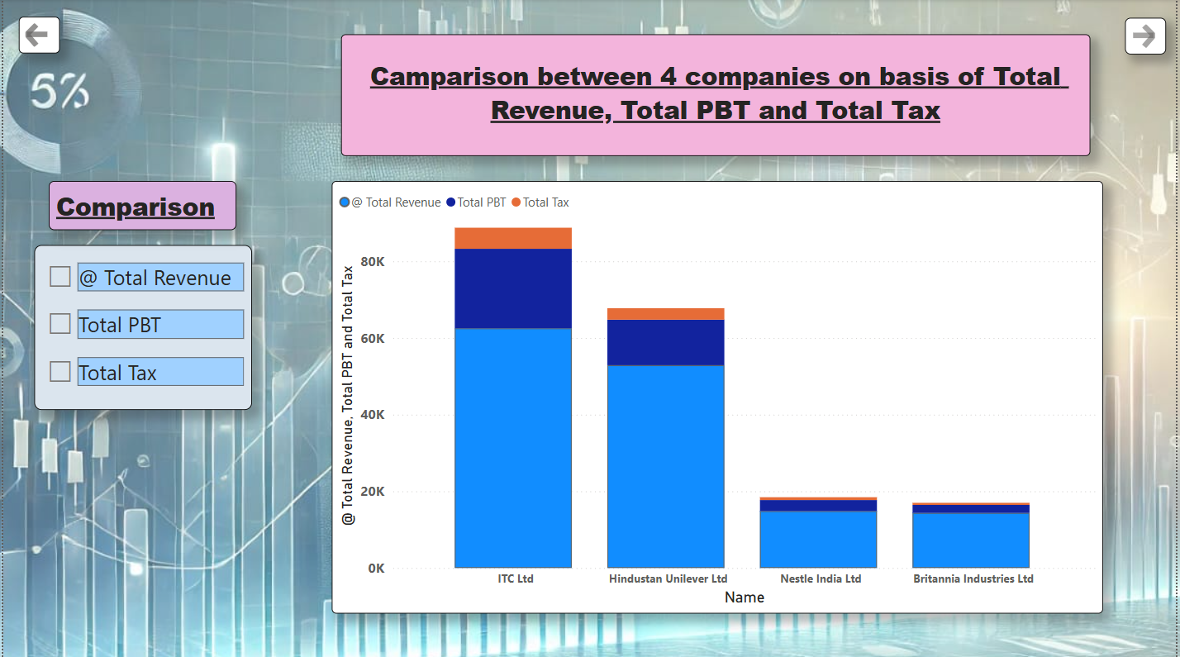
COMPARISON
Chart comparison of the four companies (ITC, HUL, Nestle India, and Britannia) across Total Revenue, Profit Before Tax (PBT), and Total Tax:
ITC Ltd leads in all three metrics → Highest revenue, PBT, and tax paid
Hindustan Unilever Ltd ranks second overall → Strong financials with good tax contribution
Nestle India and Britannia show similar revenues → But Nestle has slightly higher profitability
Gap between revenue vs. tax is significant → Indicates differences in margins and tax strategy
PBT proportion helps assess operational efficiency → ITC & HUL are more profitable per rupee earned

Slide 10
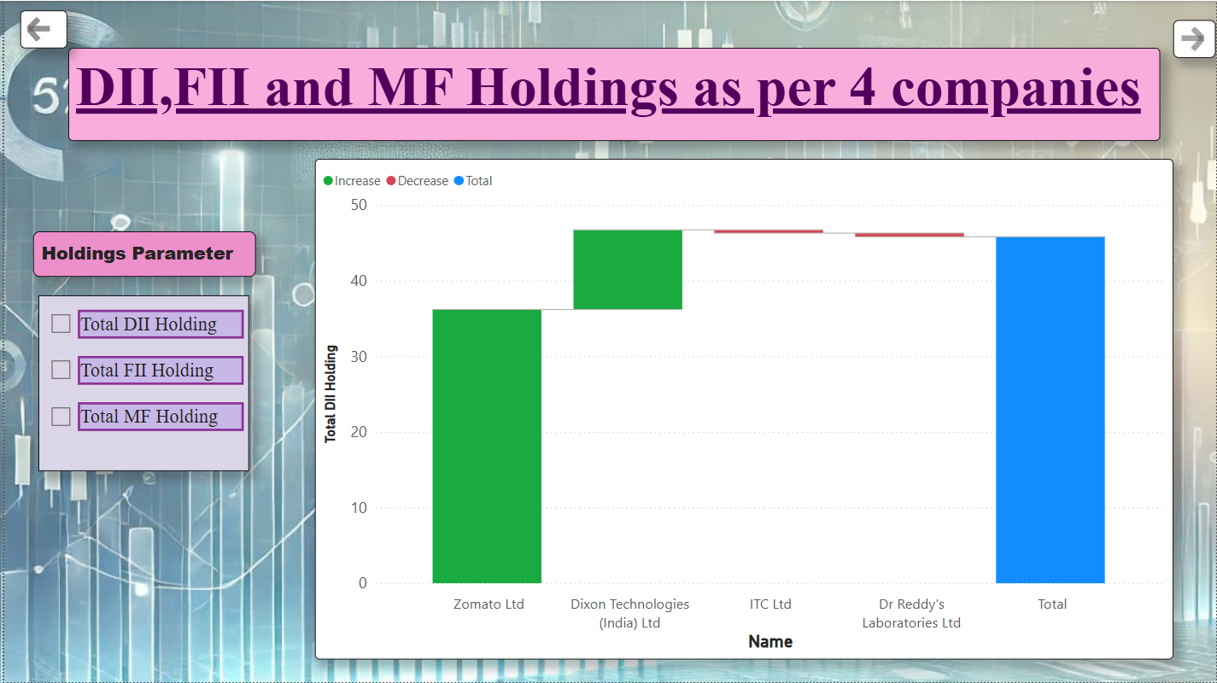
HOLDINGS
Zomato and Dixon Technologies → See significant increase in DII holdings
ITC and Dr. Reddy’s Labs → Witness a slight decrease in DII holdings
Overall trend indicates → Strong domestic institutional confidence
Dixon leads among mid-cap picks → Growing investor trust and visibility
Slight dips in large-caps may mean → Portfolio balancing or profit booking

Slide 11
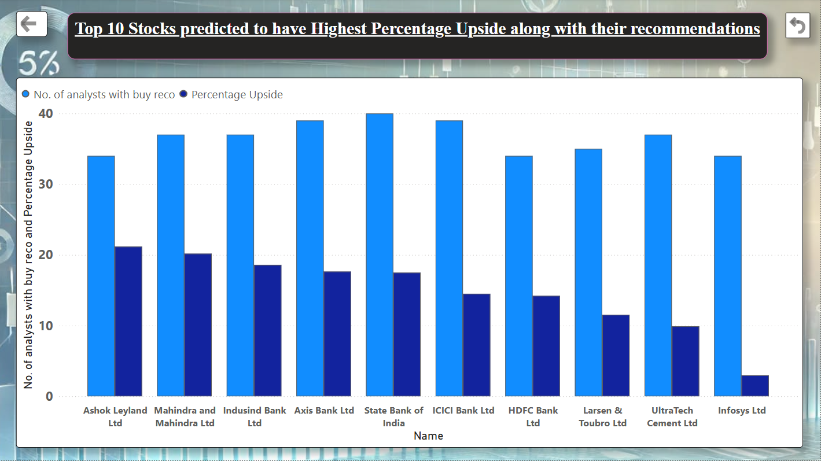
TOP 10 STOCKS by highest percentage upside & recommendation
Ashok Leyland & Mahindra & Mahindra → Lead in upside percentage & buy recommendations
Axis Bank, SBI, ICICI, HDFC Bank → High analyst confidence, strong upside signals
Infosys → Lower upside despite many buy calls – stable performer
UltraTech Cement & L&T → Moderate upside, consistent analyst backing
Overall trend suggests → Banks dominate upside potential → Analysts favor auto & infra stocks

Slide 12

THANK YOU
THANK YOU

